Slide 1
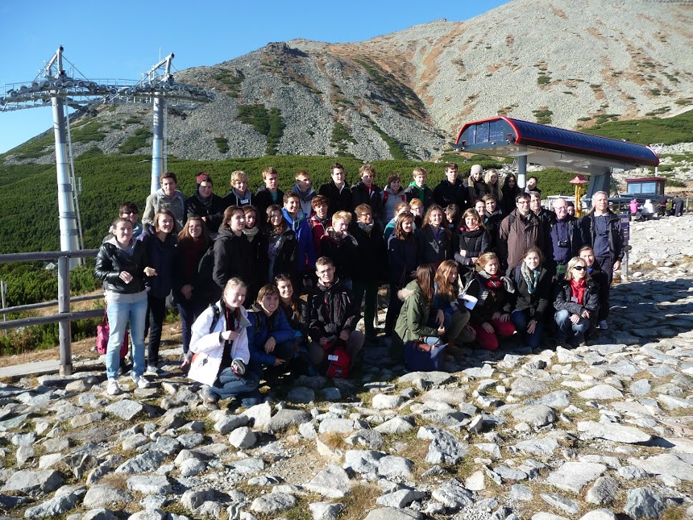
Lomnický peak
Peter Mikuš

Slide 2
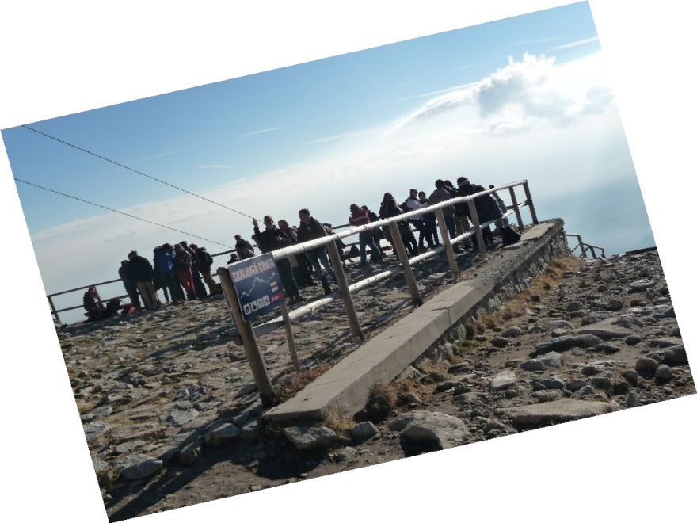
Observatory
Sun is irreplaceable source of energy
Affects Earth and communication system
Emits light, heat and plasma
Main research - Sun

Slide 3
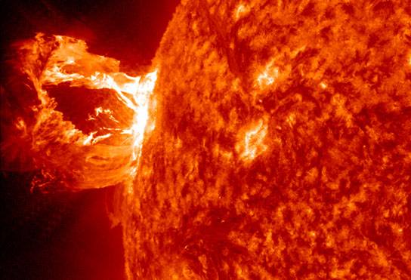
CME
Coronal Mass Ejection
Plasma (p⁺,n⁰)
Telecommunication and navigation
Earth’s magnetosphere

Slide 4
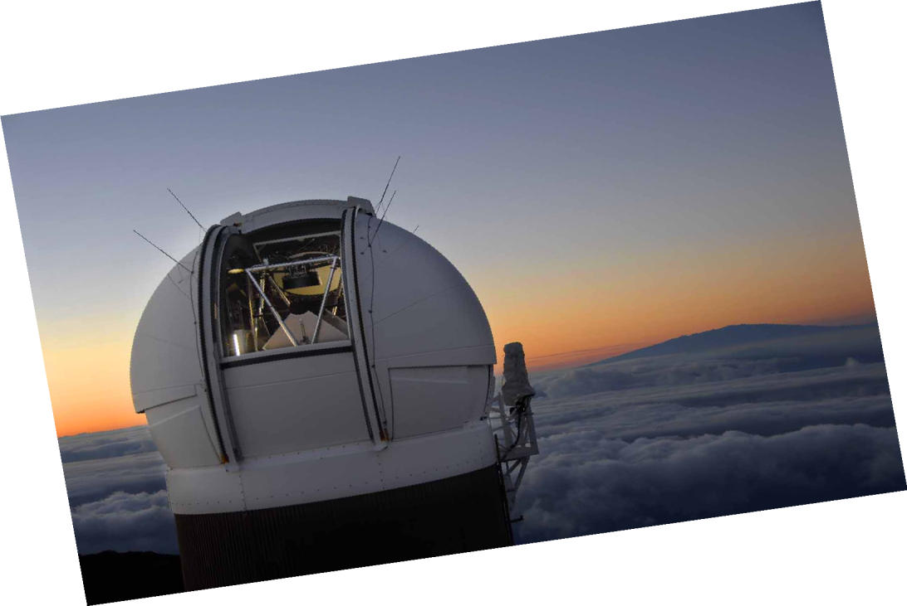
Observation
Satelite observation
X-ray telescope
Total solar eclipse
Coronograph

Slide 5
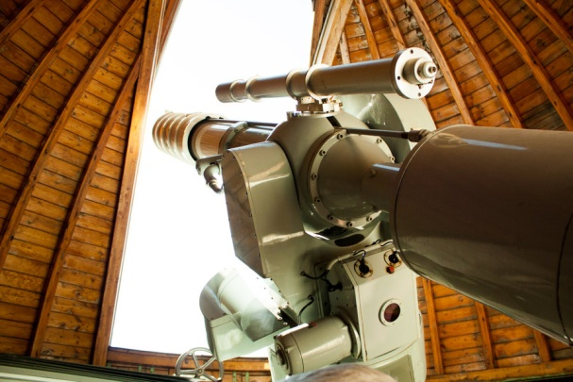
Coronograph
Artificial total solar eclipse
Solar corona observations (0,000001 of inner)
Spectrum of solar corona (green light)
Depending on solar cycle (coronal index)

Slide 6
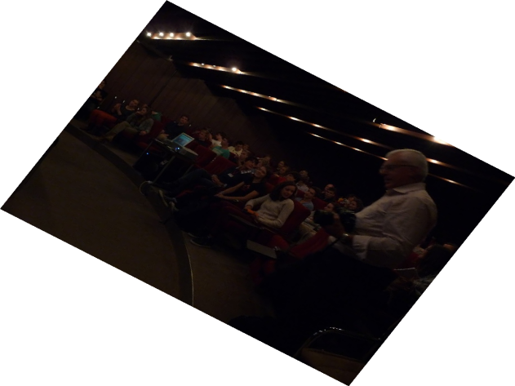
Research
Solar protuberance (prominescence)
• Colder, denser plasma to corona
• Held by solar magnetific field -> erupt
Solar flares (geomagnetic storm)
• In atmosphere causes aurora

Slide 7
Thank you for your attention

