Slide 1
Table of contents
Aneurysm
Hyperlipidemia
Heart Arrhytmia
Dissection

Slide 3
Aneurysm
Nicolas Alvarez

Slide 5
Aneurysm
a blood-filled bulge of a blood vessel
it usually affects arteries of the brain or the abdominal aorta
very dangerous – possibility of internal
bleeding

Slide 7
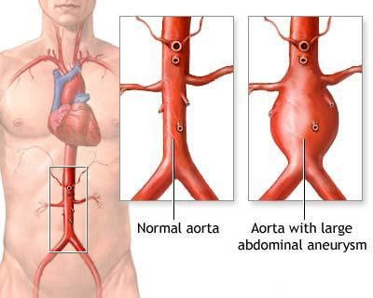
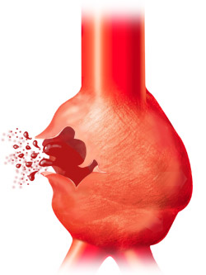
Aneurysm
Rupture of the aorta with aneurysm

Slide 9
Aneurysm
causes of aneurysm: hypertension, inflammation of the vessel wall, atherosclerosis
symptoms: sharp and severe pain
diagnostics: ultrasound or CT
treatment: surgery is needed; blood pressure and cholesterol reduction (supportive treatment)

Slide 11
Dissection
Zuzana Kaščáková

Slide 13
Dissection
the rupture of the inner wall of a vessel
it usually affects the aorta in the chest
it may cause a heart-attack, a stroke, paralysis of some parts of the body

Slide 15
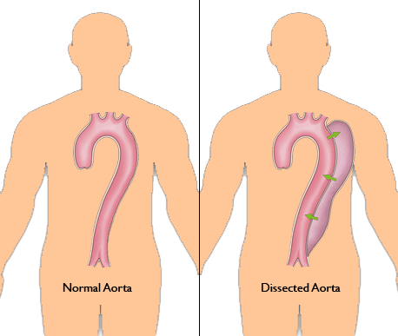
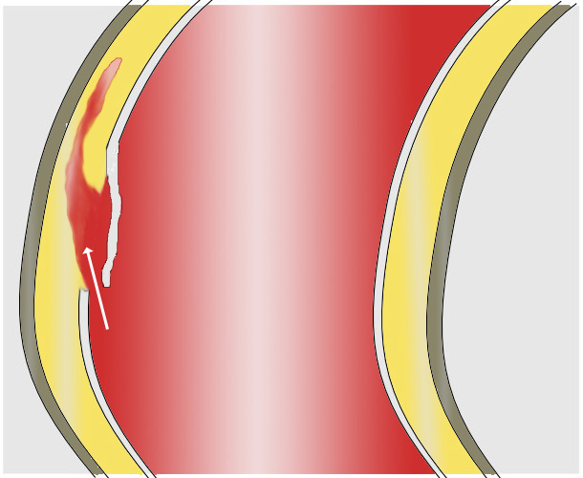
Dissection
Dissection
Comparation – normal aorta and dissected aorta

Slide 17
Dissection
causes: hypertension, atherosclerosis, thinning blood vessels
symptoms: sudden pain
diagnostics: ECG
treatment: abdominal aorta – surgery is not always needed, any other dissection requieres surgery

Slide 19
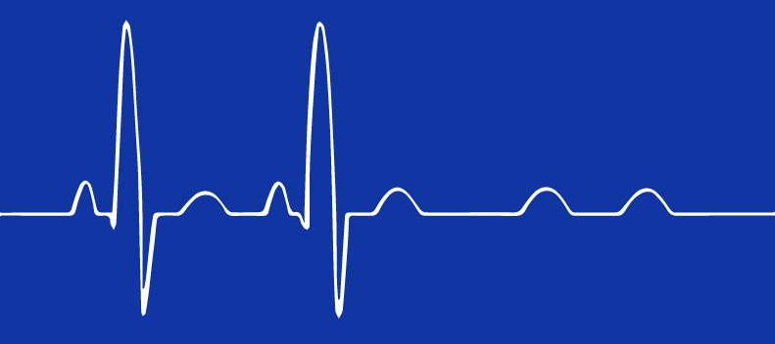
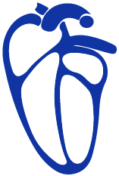
Heart arrhythmia
Marek Timoracký

Slide 20
''An irregular heartbeat is an arrhythmia.''

Slide 21
What causes an arrhythmia?
Coronary artery disease
Electrolyte imbalances in your blood (such as sodium or potassium)
Changes in your heart muscle
Injury from a heart attack
Healing process after heart surgery
Irregular heart rhythms can also occur in "normal, healthy" hearts

Slide 23
Types of arrhythmias
Premature atrial contractions
Premature ventricular contractions
Atrial fibrillation
Atrial flutter
Paroxysmal supraventricular tachycardia
Accessory pathway tachycardias
AV nodal reentrant tachycardia
Ventricular tachycardia
Ventricular fibrillation
Long QT syndrome
Bradyarrhythmias
Sinus node dysfunction
Heart block

Slide 25
Premature ventricular contractions
What Causes PVC?
Heart attack
High blood pressure
Cardiomyopathy
Disease of heart valves
Hypokalemia
Hypomagnesemia
Hypoxia
Medications
Excessive intake of alcohol
Excess caffeine intake
Stimulant drug use
Myocarditis
Cardiac contusion
Notes:
Premature ventricular contractions (PVCs) are premature heartbeats originating from the ventricles of the heart. Premature ventricular contractions are premature because they occur before the regular heartbeat.
The heart has four chambers. The upper two chambers are the atria, and the lower two chambers are the ventricles. The atria deliver blood to the ventricles, and the ventricles deliver blood to the lungs and to the rest of the body. The right ventricle delivers blood to the lungs while the left ventricle delivers blood to the rest of the body. The heartbeat (pulse) that we feel is caused by the contraction of the ventricles.
The heartbeat is normally controlled by the electrical system of the heart. The electrical system of the heart consists of the sinoatrial (SA) node, the atrioventricular (AV) node and special tissues in the ventricles that conduct electricity.
The SA node is the heart's electrical pacemaker. It is a small patch of cells located in the wall of the right atrium; the frequency with which the SA node discharges electricity determines the rate at which the heart normally beats. The SA node keeps the heart beating in a regular manner. At rest, the frequency of the electrical discharges originating from the SA node is low, and the heart beats at the lower range of normal (60 to 80 beats/minute). During exercise or excitement, the frequency of discharges from the SA node increases, increasing the rate at which the heart beats.
During a premature ventricular contraction, the ventricle electrically discharges (and contracts) prematurely before the normal electrical discharges arrive from the SA node. These premature discharges are due to electrical "irritability" of the heart muscle of the ventricles and can be caused by heart attacks, electrolyte imbalances, lack of oxygen, or medications. Immediately after a premature ventricular contraction, the electrical system of the heart resets. This resetting causes a brief pause in heartbeat, and some patients report feeling the heart briefly stopping after a premature ventricular contraction.
Premature ventricular contractions are common. Many people have premature ventricular contractions without any symptoms. Premature ventricular contractions may be more common among older patients, patients with high blood pressure, and patients with heart disease. Premature ventricular contractions can also occur in young healthy individuals without heart disease or high blood pressure.
The causes are: HA, HBP, C, DoHV, HK-low blood levels of potassium, HM-low blood levels of magnesium, HP-low amounts of oxygen in the blood, M,EIoA, ECI,SDU, MC-heart muscle inflammation, CC-heart muscle injury.

Slide 27
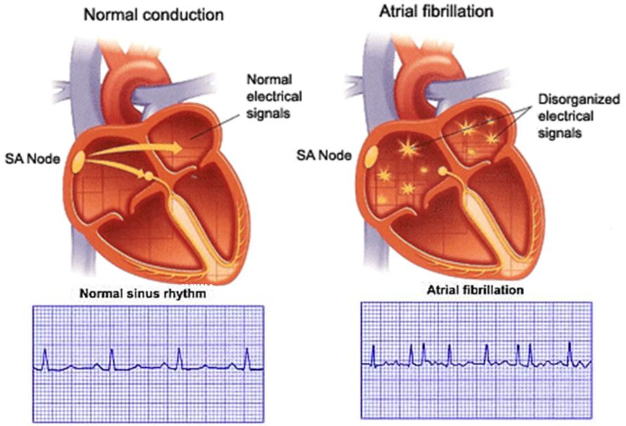
Atrial fibrillation
What Causes Atrial Fibrillation?
Poorly controlled high blood pressure (hypertension)
Heart valve problems
Coronary artery disease
Alcohol abuse
Obesity
Sleep apnea (pauses in breathing)
Thyroid disorders
Notes:
Atrial fibrilation is abnormal rhythm of the heart. Normal heart beats regulary say 60 beats/minute. This regular rhythm occurs as a result of regular electrical discharges (currents) that travel through the heart and cause the muscle of the heart to contract. In atrial fibrillation, the electrical discharges are irregular and rapid and, as a result, the heart beats irregularly and, usually, rapidly. The ventricles must deliver enough blood to the body for the body to function normally. The amount of blood that is pumped depends on several factors. The most important factor is the rate of contraction of the heart. With each beat of the heart, an electrical discharge (current) passes through the electrical system of the heart. The electrical discharge causes the muscle of the atria and ventricles to contract and pump blood. The electrical system of the heart consists of the SA node (sinoatrial node), the AV node (atrioventricular node) and special tissues in the atria and the ventricles that conduct the current. The electrical current passes from the SA node, through the special tissues of the atria and into the AV node. The AV node serves as an electrical relay station between the atria and the ventricles. Electrical signals from the atria must pass through the AV node to reach the ventricles. The electrical discharges from the SA node cause the atria to contract and pump blood into the ventricles. The same discharges then pass through the AV node to reach the ventricles. In a normal heart, the rate of atrial contraction is the same as the rate of ventricular contraction. During atrial fibrillation, electrical discharges are not generated solely by the SA node. Instead, electrical discharges come from other parts of the atria. These abnormal discharges are rapid and irregular and may exceed 350 discharges per minute. The rapid and irregular discharges cause ineffective contractions of the atria. Even at an average rate of 150/minute, the ventricles may not have enough time to fill maximally with blood before the next contraction, particularly without the normal contraction of the atria. Thus, atrial fibrillation decreases the amount of blood pumped by the ventricles because of their rapid rate of contraction and the absence of normal atrial contractions.

Slide 29
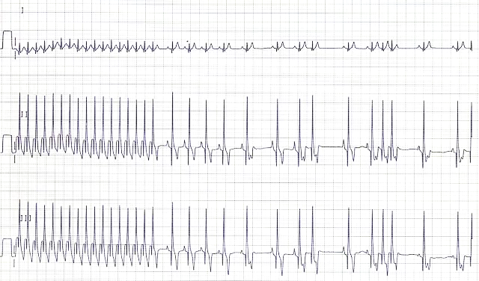
Paroxysmal supraventricular tachycardia
What Causes PST?
Excessive intake of alcohol
Excess caffeine intake
Electrolytes abnormalities
Abnormal thyroid levels
Medications
Notes:
In paroxysmal supraventricular tachycardia (PSVT), abnormal conduction of that electricity causes the atrium, and secondarily the ventricles, to beat very rapidly. It is referred to as paroxysmal, because the rapid rate can occur sporadically and without warning and may also stop on its own. The rapid heartbeat may last a few seconds or many hours. Often the PSVT resolves before the patient reaches a health care professional. In many patients with PSVT, there is a problem in the AV node and instead of having just one pathway for electricity to travel to the ventricle, there are two. This allows electricity to circle back and cause the atrium to beat more quickly than it should normally. PSVT is one of many electrical abnormalities that cause the atrium to beat too quickly. Once the heart starts to beat quickly, there is no way of predicting if and when it will return to normal rhythm on its own.

Slide 31
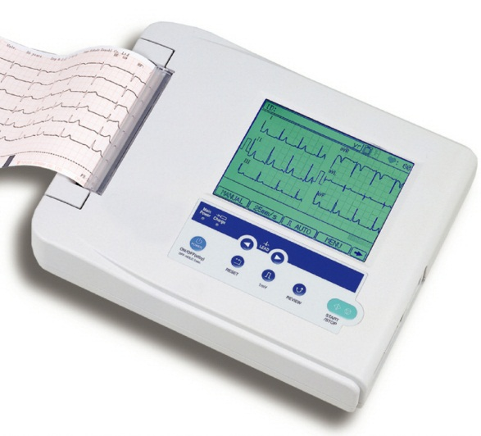
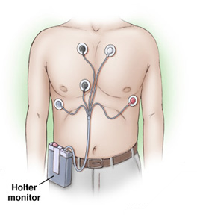
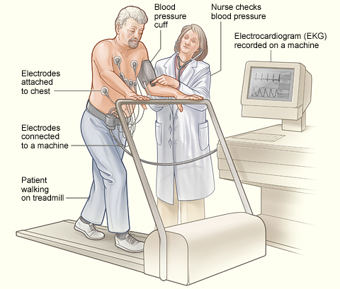
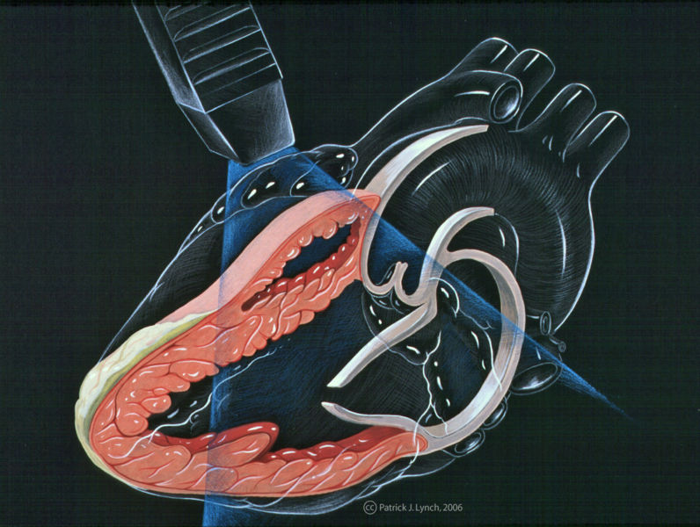
Diagnostics
Electrocardiogram (EKG)
Holter monitor
Echocardiography
Exercise cardiac stress test
Blood tests
Notes:
An electrocardiogram (EKG or ECG) is a brief recording of the heart's electrical discharges. EKGs can be performed in the doctors offices, clinics, and hospital emergency rooms.
A Holter monitor is a continuous recording of the heart's rhythm for 24 hours. Holter monitoring could be necessary to detect the Heart arrhythmia because in case of EKG arrhytmia doesn't have to accur in doctors office.
Echocardiography uses ultrasound waves to produce images of the heart's chambers and valves and the lining around the heart (pericardium). Echocardiography is useful in measuring the size of the heart chambers, the forcefulness of heart ventricle contractions, the thickness of the heart muscles, and the functioning of the heart valves.
Exercise cardiac stress testing (ECST) is the most widely used cardiac stress test. The patient exercises on a treadmill according to a standardized protocol with progressive increases in the speed and elevation of the treadmill.
Blood test can diagnose levels of pottasium, magnesium, blood oxygenation, levels of cardiac enzymes.

Slide 33
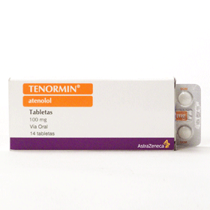
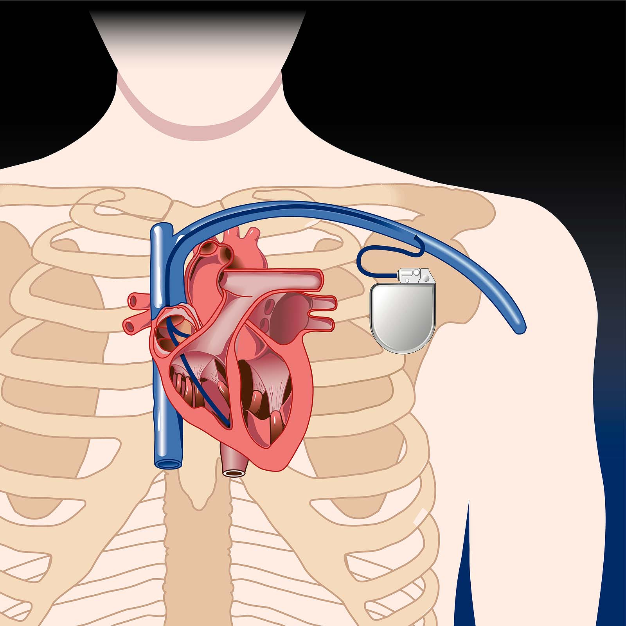
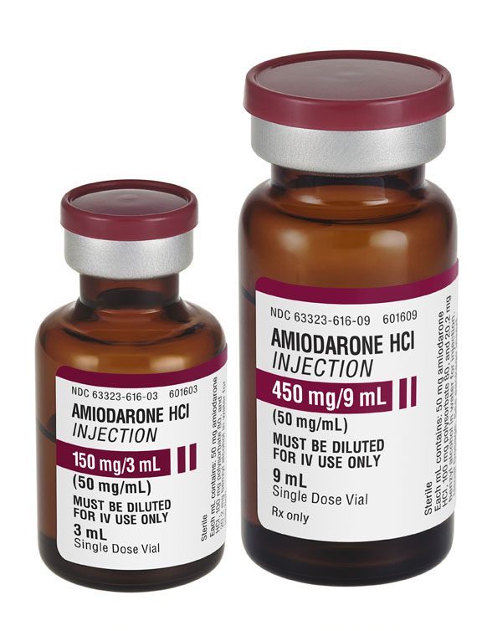
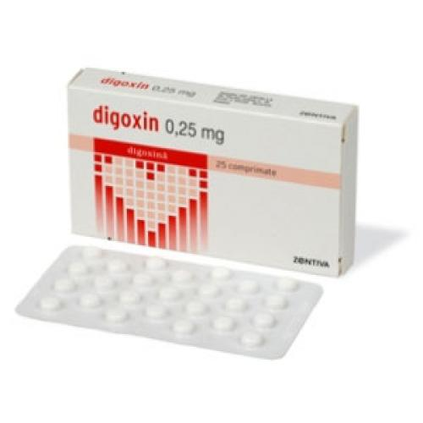
Treatment
Antiarrhythmia medications
Implantation of a pacemaker
Surgery
Notes:
Antiarrhythmia medications such as beta-blockers. Others for correction of hyperthyroidism, magnesium and pottasium levels, blood pressure.

Slide 35
Hyperlipidemia
Lenka Polláková

Slide 37
What is hyperlipidemia
abnormally elevated levels of any lipids in the blood
vs.
always your decision?

Slide 39
Classification
primary
genetic causes
check your family history
minimize your risk through diet and exercise
secondary
acquired
unhealthy lifestyle
underlying causes – drugs (diuretics, estrogens, beta blockers), diabetes

Slide 41
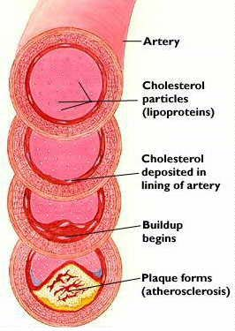
How it works
fatty substances travel in the blood attached to proteins – lipoprotein
LDL (low density lipoprotein) ,,bad cholesterol“
its excess - blockage of arteries – heart attack
HDL (high density lipoprotein) „good cholesterol“
lower level – coronary heart disease

Slide 43
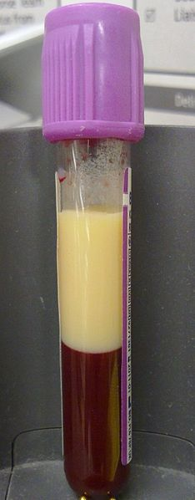
How it looks
no symptoms
BUT !
elevated chance of heart diseases

Slide 45
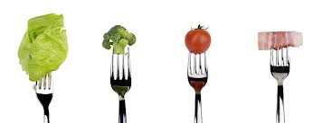
Ups, I have it
- eat healthy -
- read food labels -
- limit red meat, eggs, fried food -
- increase the amount of fiber -
- lose extra weight -
- exercise regularly -

Slide 47
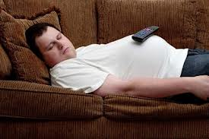
Thank you for your attention
- live healthier -

