Slide 1
Hyperbaric Chamber and Hyperbaric Oxygen Therapy
Comenius Project Activity
Presov, Slovakia
Notes:
Hi, in this short presentation, I am going to introduce to you the concept of hyperbaric chamber.

Slide 2
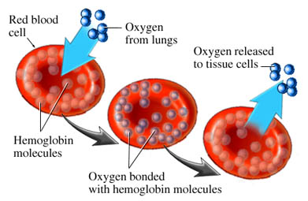
Hyperbaric Oxygen Therapy
Did you know?
Oxygen (O2) makes up approx. 21% of the air
'Hyper‘ increased
'baric‘ pressure
Providing the body with extra oxygen
Higher pressure more O2 dissolved in plasma
Which protein is normally responsible for oxygen transport?
Notes:
Hyperbaric Oxygen Therapy is a procedure in which a person is exposed to increased pressure, allowing greater absorption of oxygen through the body’s tissues.
This increased pressure allows more oxygen to reach the cells within the body therefore has many healing and therapeutic benefits.
Hemoglobin is a protein in red blood cells that transports oxygen from the lungs to the peripheral tissues of the body. it is responsible for the red color of red blood cells. Hemoglobin tightly binds oxygen from the lungs, carries it from the lungs to the peripheral tissues of the body; after unloading oxygen at the peripheral tissues, it binds carbon dioxides and returns it to the lungs to be exhaled.
The increased pressure produced in the hyperbaric chamber permits the oxygen you breathe also to be dissolved in the liquid (plasma) part of your blood.
The concept of hyperbaric oxygenation has been in existence as early as 1662 but has only gained recognition in conventional medicine over the past 50 years.

Slide 3
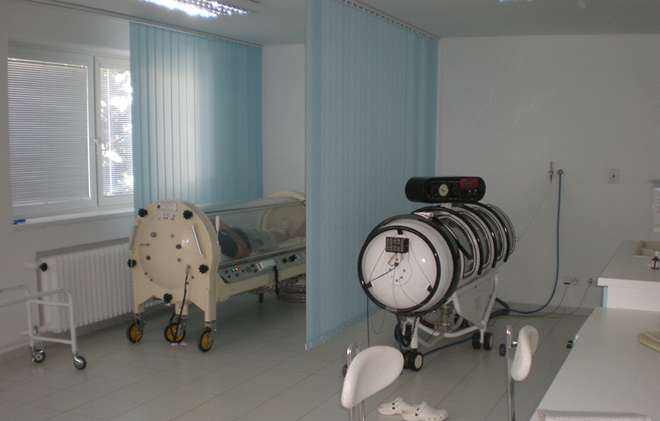
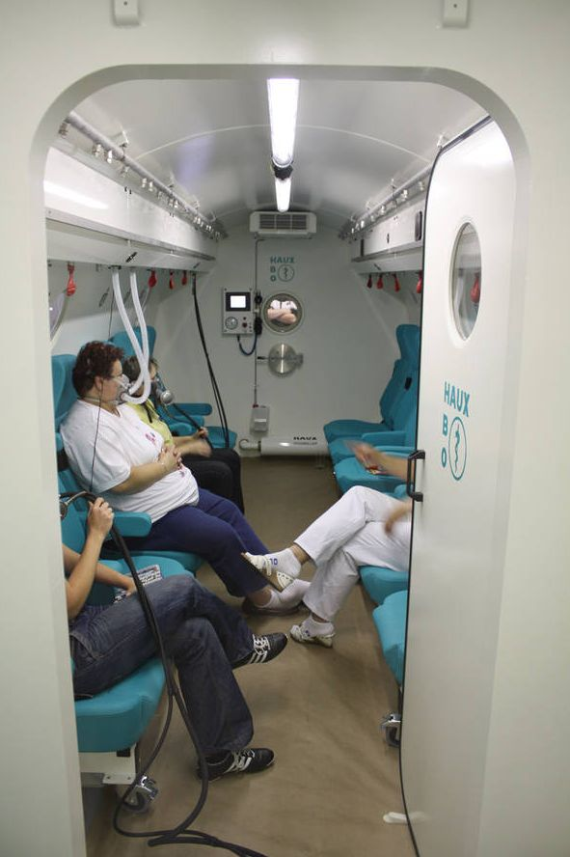
Hyperbaric chamber
Two types of chambers
A monoplace chamber (for a single person)
A multiplace chamber (for several people)
Notes:
There are two types of Chambers: Monoplace that holds a single person and Multiplace which is a large chamber where 5 or 6 patients (hence the name multiplace) can be treated at once.
The Muliplace Chamber is not suitable for some elderly, disabled and children because the oxygen is delivered by wearing a mask and the chamber is pressurized with room air.
The effect of the treatment is the same. The advantages depend upon the scale of the facility's operation.
Only a monoplace chamber can provide oxygen to the whole body, thus it is more suitable for curing thermal burns or wounds.
In monoplace, you can not access the patient, where as in Multiplace, you have access to the patient, as well as equipment and resources to assist.

Slide 4
The Process
Patient is placed in a chamber and pressurized (up to 3 atm)
Two ways of providing oxygen
Therapy lasts ca 90 minutes
just one part of the body
through a gas mask, which delivers 100 percent oxygen
you are completely immersed in 100 percent oxygen (monoplace only)
Effective?
Notes:
Hyperbaric oxygen therapy can be done in a number of ways. It can be given in a special type of room called a hyperbaric oxygen chamber. In this setting, you are completely immersed in 100 percent oxygen delivered at high pressure (only in monoplace chambers). It can also be given through a gas mask, which delivers 100 percent oxygen to your lungs. The rest of your body is at normal oxygen levels, but still under higher pressure than normal. In some instances, “topical” hyperbaric oxygen therapy can be applied to just one part of the body. If the wound is on your leg, for example, your leg could be wrapped in a plastic bag that is filled with 100 percent oxygen under pressure. Although this localized form of topical oxygen therapy is easier to do and more affordable, its effectiveness, compared with the other forms of hyperbaric oxygen therapy, is questionable, according to the latest research.

Slide 5
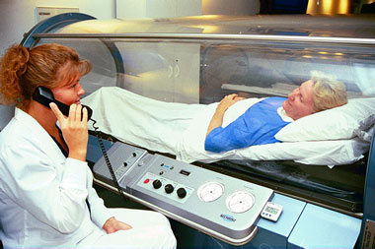
Conditions Treated With Hyperbaric Therapy
- Decompression illness
- Carbon Monoxide Poisoning
- Gas Gangrene
- Severe Anemia
Thermal Burns
Crush Injury
Diabetic Wounds
acute blood loss where a blood transfusion is not possible
heart disease
HBO has not yet been proven to be effective in curing autism,
cancer, diabetes, HIV/AIDS,
Alzheimer's disease
or asthma .
Notes:
HBO treatment can help in a number of different situations where body tissues have suffered from a decrease in oxygen levels. These include:
Decompression illness
- Carbon Monoxide Poisoning
- Gas Gangrene
- Severe Anemia
Thermal Burns
Crush Injury
Diabetic Wounds
- acute blood loss where a blood transfusion is not possible
hyperbaric oxygen therapy (HBOT) has not been clinically proven to cure or be effective in the treatment of cancer, autism, diabetes, asthma.

Slide 6
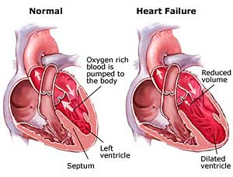
Treating Cardiovascular Disease with HBOT
Ischemic heart disease reduced blood (oxygen) supply to the heart
Main benefits from HBOT:
HBO has long-term and short-term
protective effects for a person with
a heart problem.
Patients with cardiac pain from
ischemic heart disease experience total relief.
Using HBOT in conjunction with various drugs enhances the effectiveness of the drugs.
HBOT exerts antiarrhythmic action on the heart.
Notes:
The nature of heart disease is such that insufficient oxygen is getting to the heart. This results in the various discomforts which affect a patient: difficulty with breathing, inability to exert oneself, pressure in the chest, and other problems. Breathing normal air results in mere 0.3 ml of oxygen dissolving into each 100 ml of blood.
The need in heart disease is to get more oxygen molecules into the body and brain.
Scientific research has shown that there are several benefits from hyperbaric oxygen therapy for cardiac patients such as:
HBO has long-term and short-term protective effects for a person with a heart problem.
Patients with cardiac pain from ischemic heart disease experience total relief.
Using HBOT in conjunction with various drugs enhances the effectiveness of both the oxygen and the drugs.
HBOT exerts antiarrhythmic action on the heart.

Slide 7
Hyperbaric Chamber in Presov
The pressure rises to 2.5 times the normal air pressure.
The session lasts approx. 90 minutes.
In case of emergency, decompression can take place
in less than 20 seconds.
Notes:
You lie on a table that slides into a clear plastic tube.
You should relax during the procedure. You can listen to music.
You are able to talk to the therapist at any time.
The chamber is sealed and then filled with pressurized oxygen.
The pressure rises to 2.5 times the normal air pressure.
The session lasts approximately 90 min.
In case of emergency, decompression can take place
in less than 20 seconds.

Slide 8
Thank you for your attention
Authors:
Dominika Salamonova
Katarina Pavukova
Sources:
http://www.hyperbaricoxygentherapy.org.uk/article-hyperbaric-oxygen-and-your-heart-73 http://cdn.tier1group.com/media/ppt/EIM201203070830.ppt
http://www.longbeachhyperbaricmedicine.com/index.html
http://www.hyperbarickecentrum.sk/

